Slide 1
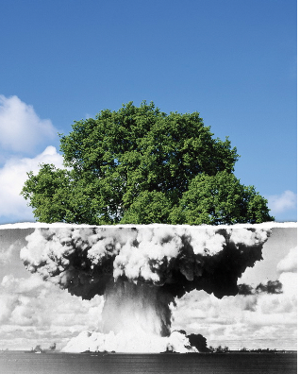
A short guide and introduction to the wonderful and frustratingly complex, yet critically important world of Public Policy
Maximizing the public good (but sometimes the public bad) since the beginning
Prof. Porteux and PPL 101

Slide 2
Public Policy is politics, but not exactly
Polisci Subfields | Main Focus | Key Questions | How It Differs from Public Policy
Political Theory | Normative ideas about justice, rights, governance | What is a just society? What should government do? | Focuses on philosophical foundations, not practical implementation
Comparative Politics | Comparison of political systems and institutions | How do democracies vary? What explains regime change? | Analyzes how systems function; public policy focuses on what systems do to solve problems
International Relations (IR) | Relations between states, war, diplomacy, globalization | What causes conflict? How do international norms evolve? | Concerned with global actors and dynamics, while public policy is often domestic or subnational—or how domestic politics affects apex international interactions.
Area Studies (within a Political Science department) | Politics and institutions within a specific country | How does Congress/Parliament function? What drives voter behavior? | Focuses on political behavior and institutions; public policy focuses on policy outcomes and impact
Public Administration | Management of government operations and bureaucracies | How can government agencies be efficient and accountable? | Closely related to public policy, but more focused on implementation and organizational behavior
Public Policy | Design, analysis, implementation, and evaluation of government actions | What works? How can we solve public problems? | Aims to be applied, interdisciplinary, and solution-focused

Slide 3
Some more differences…
 | Political Science | Public Policy
Primary Purpose | Understand and explain political ideas, behavior, and systems | Solve real-world problems through government action. “ism`s are respected, but less useful tools for public policy. The right tool for the right job!
Use of “-isms” | Used to classify and analyze ideologies and theoretical frameworks (e.g., liberalism, realism, Marxism, feminism). Central in IR, limited in Comparative Politics. | Minimal — focuses on practical tools, data, and implementation rather than ideological frameworks. ”My house is burning!!” : Political Science: what is the nature of fire? Public Policy: Yo homey! Put the fire out!!
Examples of “-isms” | E.g. Liberalism, constructivism, socialism, realism (and the many offshoots) | Instead uses concepts like cost-benefit analysis, policy design, evaluation, governance models
Typical Questions | What is the role of the state in a liberal society? or How does realism explain war? | What policy reduces poverty most effectively? or How do we implement climate adaptation strategies?
Orientation | Theoretical, explanatory, IMPORTANT | Applied, pragmatic, often evaluative, also IMPORTANT
Methods | Often theory-driven, comparative, philosophical | Theory and data-driven, interdisciplinary, often experimental or evaluative

Slide 4
The other social sciences are also related to politics (i.e. power), but are distinct (obviously)
Discipline | Primary Focus | Key Questions | Typical Methods | Main Purpose | Relation to Public Policy
Public Policy | Design, implementation, and evaluation of government actions | What policies work? How can we solve public problems? | Mixed methods (quantitative + qualitative, modeling, evaluation, case studies). | Applied problem-solving; real-world impact | Integrates tools and insights from all social sciences to create and assess policy
Economics | Allocation of scarce resources, incentives, markets | How do individuals and markets respond to incentives? What is efficient? | Mathematical modeling, statistics, cost-benefit analysis | Predicting and optimizing behavior/outcomes | Informs policy with models and data; efficiency focus, but may neglect equity
Sociology | Social structures, inequality, institutions, culture | How do social norms, class, race, and institutions shape behavior? | Surveys, ethnography, historical analysis | Understand social behavior and change | Highlights equity, justice, and social context often missed in technocratic policy
Anthropology | Human cultures, practices, and belief systems (often cross-cultural) | How do cultures and traditions shape behavior? | Ethnography, fieldwork, participant observation | Deep cultural understanding | Valuable for context-sensitive policy, especially in development and indigenous contexts
Psychology | Human cognition, emotion, and behavior | Why do people behave the way they do? | Experiments, surveys, behavioral observation (usually university students are the subjects…what`s “WEIRD” about that)? | Understanding individuals and mental processes | Supports behavioral insights for policy (nudges, decision-making, etc.)

Slide 5
How does PPL relate to the physical and biological fields?
Discipline | Primary Focus | Key Questions | How It Connects to Public Policy | Examples of Policy Impact
Biology | Life systems, organisms, ecosystems, genetics | How do living systems function and evolve? | Informs health, environment, agriculture, and biotechnology policies | Biodiversity protection, GMOs, vaccine development, biotech regulation
Environmental Science / Ecology | Interactions between organisms and their environments | What are the causes and consequences of environmental change? | Shapes environmental policy, conservation, and climate adaptation | Climate change regulation, endangered species acts, pollution control. IT`S TOO DARN HOT IN JAPAN!!
Chemistry | Composition and properties of matter; chemical reactions | What substances are in our environment and how do they interact? | Influences public health and environmental safety regulations | Chemical safety standards, drug approvals, clean water policies
Physics | Matter, energy, forces, and laws of the universe | How do physical systems behave? | Informs infrastructure, energy policy, and tech regulation | Nuclear energy policy, radiation standards, transportation infrastructure, FUKUSHIMA!!
Geosciences / Earth Science | Earth's physical structure, natural hazards, resources | How do natural systems like the atmosphere and tectonics function? | Guides disaster preparedness, resource management, and climate policy | Earthquake zoning laws, fossil fuel extraction regulation, weather forecasting. EARTHQUAKES..Oh MY!
Health Sciences / Medicine | Human health, disease, diagnostics, and treatment | What causes disease and how can it be prevented or treated? | Directly shapes health policy, access to care, and public health strategies | Universal healthcare design, pandemic response, mental health policy. COVID POLICY!!
Agricultural Science | Crop production, soil health, food systems | How can we sustainably grow food and manage land? | Guides food security, land use, and sustainable farming policies | Pesticide regulation, subsidies, land conservation
Computer Science / Data Science | Information systems, algorithms, computation | How can we use data and computation to solve problems? | Enables digital governance, cybersecurity, algorithmic regulation | AI policy, data privacy laws, e-government services

Slide 6
The curriculum for students of PPL
Master core analytical skills essential for effective public policy analysis and evidence-based decision-making
Gain a comprehensive understanding of policy institutions and processes—spanning political, economic, and social systems—and their implications for policy design and implementation.
Develop and refine professional communication skills suited to diverse policy environments and audiences
Strengthen leadership, management, and strategic decision-making abilities relevant to public and nonprofit sectors
Demonstrate the capacity to integrate analytical, institutional, communication, and managerial competencies in addressing complex policy challenges
Create meaningful, real-world impact by contributing to policies that improve lives and advance the public good
Make a real-world, positive difference in people`s lives

Slide 7
Ok, what the heck is public policy anyways, can you just summarize in normal words?
Public policy is the outcome of strategic bargaining among political actors, each seeking to maximize their own interests, given the constraints and incentives they face.
Public policy is grounded in evidence-based, applied social science theory, drawing on both quantitative and qualitative analyses. Quantitative methods help identify patterns/causal relationships and measure impact, while qualitative approaches provide analysis of causal mechanisms, crucial context, depth, and insight into lived experiences. Together, mixed methods strengthen the validity, relevance, and effectiveness of policy decisions.

Slide 8
Continued
At its core, public policy is about solving complex societal problems through collective decision-making. Governments, NGOs, communities, and international organizations all aim to create rules, programs, and incentives to shape behavior in ways that promote public welfare.
But here’s the FUNDEMENTAL puzzle/Dependent variable:
How do you get people, institutions, and nations — all with their own goals, incentives, and constraints — to work together toward shared outcomes?

Slide 9
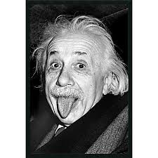
Remember KIDS:
“More people will die of bad politics than bad physics.”
Who said that?

Slide 10
The key puzzles and challenges in Public Policy
One of the most enduring and complex puzzles in public policy is the problem of coordination and cooperation among diverse actors with differing incentives, especially in contexts involving shared resources, public goods, or long-term outcomes like climate change, healthcare, or education reform.
Governments and policymakers must navigate fragmented interests, limited information, and institutional constraints, while trying to design interventions that are both effective and equitable. The central challenge is: How can collective decisions be made and implemented when individuals or groups may have strong incentives to act in their own self-interest, rather than in the public interest?
Where do we begin? Well—generalizable frameworks of course.

Slide 11
Generalizable frameworks (also see the appendix)
Frameworks are like mental maps that help us systematically analyze policy problems across diverse contexts.
One of the most influential is Elinor Ostrom’s Institutional Analysis and Development (IAD) Framework.
It asks: Who are the actors? What rules shape their interactions? What incentives or constraints are present?
Such frameworks help us move beyond anecdotal thinking and make comparisons across cases — whether we’re looking at water governance in India or fisheries management in China.
They help ensure that our diagnoses are comprehensive, and that we’re not missing hidden institutional or behavioral variables.

Slide 12
How Frameworks, Strategic Models, and Data-Driven Approaches Help
1) Generalizable Frameworks (e.g., the Institutional Analysis and Development framework by Elinor Ostrom) provide a systematic way to analyze institutions, actors, and rules across various policy contexts. These frameworks help compare cases, identify patterns, and understand institutional dynamics.
2) Models of Strategic Interaction (e.g., game theory) are vital in analyzing how actors behave when their decisions are interdependent. These models can illuminate issues like free-riding, principal-agent problems, and regulatory capture. For instance:
In climate negotiations, game theory models show why nations may under-contribute to global efforts unless enforcement or incentives are built in.
In education policy, they help design incentive-compatible schemes for teachers or schools.

Slide 13
Models of Strategic Interaction—what are they and why are you punishing us?
This is where game theory and rational choice models come in.
These models examine how decision-makers behave when their choices affect — and are affected by — others.
Examples:
In environmental policy, countries may underinvest in emissions reduction because each wants the other to act first. That’s a classic prisoner’s dilemma.
In education, a government might set performance targets, but if teachers don’t trust the metrics or face conflicting incentives, they might “teach to the test” rather than improve learning — a principal-agent problem.
By modeling such interactions, we can:
Predict (probabilistically!!) unintended consequences,
Design better incentive systems,
And identify the conditions under which cooperation emerges.

Slide 14
Example of computational modeling in public policy—the big frontier!
Function | Description | Example
Simulation of Complex Systems | Models dynamic interactions between multiple variables or actors over time | Simulating traffic flow for urban planning or disease spread in pandemics
Policy Scenario Testing ("What-If" Analysis) | Tests how different policies would play out under various conditions | Modeling the impact of different carbon tax rates on emissions and the economy
Forecasting and Prediction | Uses historical data and patterns to predict future outcomes | Predicting voter turnout or economic growth under different policy regimes
Optimization and Resource Allocation | Finds the most efficient use of limited resources | Allocating healthcare budgets or emergency response units optimally
Behavioral Modeling | Simulates how individuals or groups make decisions | Modeling consumer response to a sugar tax or farmer behavior under subsidy changes
Stakeholder Interaction and Game Theory Modeling | Models strategic decision-making between competing actors | Understanding negotiation dynamics in international climate agreements
Agent-Based Modeling (ABM) | Simulates the actions of individual "agents" (people, firms, governments) to see how macro outcomes emerge | Exploring segregation patterns in housing or cooperation in resource sharing
System Dynamics Modeling | Focuses on feedback loops, delays, and accumulations in large-scale systems | Modeling long-term effects of education reform on economic growth

Slide 15
Data driven approaches
High-quality, unbiased data are essential for effective policy development. While some degree of bias is inevitable, it is critical to recognize its direction and implement strategies to mitigate its impact.
Over the past decade, advancements in big data analytics, machine learning, and causal inference have significantly transformed the field of policy analysis. Governments and researchers are increasingly utilizing randomized controlled trials (RCTs) to rigorously evaluate interventions across sectors such as education, public health, and social protection.
Predictive analytics now enable the identification of high-risk areas—such as neighborhoods susceptible to flooding—or individuals—such as students at risk of dropping out—thereby allowing for more targeted and proactive interventions.
Beyond their technical capabilities, data-driven approaches enable the customization of policy solutions to local contexts and support rigorous impact evaluation. This facilitates a continuous feedback loop between policy design, implementation, and reform.
Collectively, these tools—including analytical frameworks, strategic models, and empirical data—empower policymakers to better understand, anticipate, and address complex societal challenges.

Slide 16
Example: Why is the Collective Action problem so critical to Public Policy?
Collective Action Theory deals with how groups of individuals or organizations can work together to achieve shared goals, especially when there are incentives to defect or free-ride.
Originating from Mancur Olson’s (1965) work, the theory highlights how INDIVIDUAL rationality can lead to COLLECTIVELY irrational outcomes.
The classic example is the “Tragedy of the Commons”, where shared resources are overused and depleted because no individual actor has sufficient incentive to conserve. NOTE: this was extended by Elinor Ostrom, who won the 2009 Nobel Prize.
Acemoglu and Robinson won in 2024, for related work on Inclusive Institutions. Nobel Prizes in the field of Economics (related to public policy), almost always have a form of collective action theory at the core. Public Policy students (and professors, need to know this).

Slide 17
Continued
In public policy proper, collective action theory is critical because:
Many of the most pressing issues (e.g., public health, national defense, environmental protection) require coordinated efforts.
Policies often fail not because of poor design, but due to inadequate enforcement, weak cooperation, or lack of stakeholder buy-in.
Understanding collective action problems helps in designing institutions and incentive structures that promote cooperation and long-term outcomes.
Basically, nearly all major policy problems involve some kind of collection action dilemma (think political institutions as a solution or cause of problems, in terms of PPL 210).

Slide 18
Examples
Climate Change
Everyone benefits from global emissions reduction.
But it’s costly for any one country to act alone.
Hence, international agreements like the Paris Accord struggle with enforcement and compliance.
Vaccination Programs
Herd immunity depends on widespread participation.
Yet individuals may skip vaccination if they think others will carry the burden.
Anti-Corruption Efforts
If no one believes others will act with integrity, they may conclude that corrupt behavior is “rational.”

Slide 19
Example of a key issue RIGHT NOW (we can talk about the perils of anarchy at a different time)
Democratic Backsliding | Anti-Democratic/populist preferences | Fascism
Triggering Conditions | Emerges when people feel elites are ignoring their needs; promises to return power to "the people" | Arises during crises (economic, social, identity), when collective fear or anger seeks authoritarian resolution
Collective Action Problem | Populist leaders often solve coordination problems by offering simple narratives ("us vs. them” “native-born vs immigrants”) and mobilizing/manufacturing mass discontent | Fascist regimes exploit or manufacture threats to unify people under coercion or nationalism, bypassing deliberation. Creating crisis where crisis might not actually exist.
Identity and Belonging | Creates in-group solidarity (the "real people") vs. outsiders or elites, easing collective mobilization | Fascism intensifies this by promoting racial, national, or ideological purity as a basis for unity
Mechanisms of Mobilization | Charismatic leadership, direct appeals, anti-institutional rhetoric | Propaganda, mass rallies, surveillance, paramilitary groups
Institutional Consequences | Weakens pluralism; may erode institutions but keeps democratic façade | Destroys democratic institutions, replaces collective action with coercion and submission to the state or leader
Policy Relevance | Reshapes public policy by bypassing expertise, centralizing authority | Fascism uses policy as a tool of domination (e.g. censorship, repression, militarization)
See Levitsky and Ziblatt (2018): “How Democracies Die”; Inglehart and Norris (2019) (Cultural Backlash)

Slide 20
Continued
Public policy, must be designed to:
Lower transaction costs,
Create enforcement mechanisms,
Align incentives, and
Build trust and norms that support cooperation.
For instance, Ostrom’s research on common pool resources showed that communities can — under the right conditions — govern resources sustainably without top-down regulation. This shattered assumptions that only the market or the state could solve collective action problems.
So, collective action theory not only diagnoses policy failures, it also illuminates pathways for institutional innovation.

Slide 21
To wrap up
The central challenge in public policy is aligning individual actions with collective goals — in a world of conflicting incentives, incomplete information, and institutional COMPLEXITY!! (ask me about the field of Complex Systems next class)
Generalizable frameworks help us see the structure of problems.
Strategic models help us anticipate behavior.
Data-driven methods help us evaluate and adapt interventions.
And collective action theory reminds us that solving public problems is not just technical, but fundamentally social and institutional.
Whether you’re working on sustainability, urban development, or global health, the tools we’ve discussed today are essential to understanding why policies succeed or fail — and how we can design better ones.

Slide 22
Wrap up continued….
A key question that everyone involved in public policy must answer is:
What problems does the specialist work on, how does their work get beyond mere opinion, how are their models verifiable and scientific, and how does their ACTUAL work help to reduce the problem?
In other words, is their work CONSEQUENTIAL and PRACTICAL? How can that impact be demonstrated?
The next two pages summarize key Public Policy theories, and subsequently, the main tools at hand

Slide 23
Theory | Core Idea | Assumptions | Key Actors | Strengths | Limitations
Rational Choice Theory | Policy outcomes result from self-interested individuals maximizing utility | Actors are rational and strategic | Individuals, voters, politicians | Clear, predictive models; useful for analyzing incentives | Oversimplifies motivations; limited in complex social contexts
Institutionalism (Historical/New) (gosh darn it, that`s an ism). I didn`t say we don`t like isms :P | Institutions shape policy by structuring rules, norms, and path dependencies | Institutions constrain and enable behavior | Government bodies, legal systems, norms | Emphasizes structure, history, and context | Can be too deterministic; underestimates agency
Multiple Streams Framework (MSF) – Kingdon | Policy change happens when three streams (problems, policies, politics) converge | Policy windows are rare and unpredictable | Policy entrepreneurs, politicians, bureaucrats | Captures policy timing and agenda-setting | Lacks predictive power; loosely structured
Punctuated Equilibrium Theory (PET) – Baumgartner & Jones | Policy change is usually incremental, with occasional large shifts | Policymaking is characterized by stability punctuated by disruption | Policy subsystems, media, interest groups | Explains sudden shifts in long-standing policies | Less focus on actor-level strategy
Advocacy Coalition Framework (ACF) – Sabatier | Policy change occurs through competition between coalitions sharing beliefs | Beliefs, not just interests, drive behavior | Advocacy coalitions across sectors | Captures long-term change and ideology | Requires long timeframes and detailed data
Narrative Policy Framework (NPF) | Policy is shaped by the stories actors tell to frame issues | Narratives influence perception and action | Policy actors, media, public | Connects discourse to policy change | Still developing; less formalized
Elite Theory | Policy reflects the interests of powerful elites | Power is concentrated | Political/economic elites | Explains inequality in policymaking | Cynical view; less attention to mass participation
Pluralism (argh…that`s a another ism). It`s all good though-–we still like them ☺ | Policy emerges from competition among diverse interest groups | Power is dispersed in democracy | Interest groups, public, government | Highlights democratic competition | Underestimates elite dominance
Social Construction Framework – Schneider & Ingram | Policy reflects and reinforces social stereotypes about target populations | Perceptions matter as much as facts | Policymakers, public, target groups | Explains why some groups are favored | Hard to model or predict
Policy Diffusion Theory | Policies spread across jurisdictions through learning, emulation, or competition | Governments observe and adapt others’ policies | Governments, networks | Explains policy transfer and convergence | Doesn’t explain policy origin well
Collective Action Theory – Olson/Ostrom | Group cooperation is difficult without incentives or institutions | Rational individuals won’t cooperate unless incentivized | Groups, governments, institutions | Explains public goods problems and cooperation | May ignore norms, culture, emotion

Slide 24
Methodological Approach | Definition / Focus | Typical Uses | Advantages | Disadvantages
Qualitative Methods | In-depth exploration of meanings, processes, and contexts (e.g., interviews, case studies, ethnography) | Understanding complex policy processes, stakeholder views, institutional dynamics | Rich contextual insights; captures nuance and complexity | Limited generalizability; potential researcher bias
Quantitative Methods | Use of numerical data and statistical techniques to test hypotheses and identify relationships | Policy evaluation, cost-benefit analysis, large-scale comparisons | Empirical rigor; enables generalization and replicability | Can miss contextual factors; data availability can constrain scope
Mixed Methods | Combines qualitative and quantitative approaches in a single study or research design | Comprehensive evaluations, triangulating data, validating findings | Balances depth and breadth; cross-validates findings | Time-consuming; requires expertise in multiple methods
Comparative Policy Analysis | Systematic comparison of policies across cases (e.g., countries, regions, time periods) | Cross-national learning, policy transfer, diffusion studies | Identifies patterns and differences; enhances theory-building | Context sensitivity may limit comparability; data harmonization issues
Case Study Approach | Detailed investigation of a single or few policy cases | In-depth process tracing, institutional analysis, theory development | High contextual validity; useful for theory generation | Limited external validity; findings may not generalize
Experimental Methods (incl. RCTs) | Random assignment to treatment/control groups to isolate policy effects | Evaluating program impact (education, health, cash transfers, etc.) | Strong causal inference; considered gold standard | Ethical/practical limits; can lack external validity
Quasi-Experimental Methods | Uses natural experiments or statistical techniques (e.g., DiD, IV) when randomization is not possible | Estimating causal effects of policy interventions in non-randomized settings | Causal insights with real-world data | Assumptions (e.g., parallel trends) can be fragile; complex to implement
Simulation & Modeling | Creating models (e.g., agent-based, systems dynamics) to simulate policy scenarios | Forecasting, scenario planning, complex system behavior | Useful for long-term or complex systems; tests policy under uncertainty | Requires assumptions and calibration; results may be sensitive or speculative
Cost-Benefit / Cost-Effectiveness Analysis | Compares policy costs and benefits in monetary or efficiency terms | Project evaluation, resource allocation, policy prioritization | Clarifies trade-offs; aids decision-making | Can undervalue non-quantifiable outcomes (equity, justice); ethical concerns

Slide 25
Most rigorous policy research today uses mixed methods, acknowledging the strengths and limits of each approach.
Method choice should be driven by the research question, not by disciplinary bias or convenience (e.g. Is your research question A+ and methods a C-, or is your question a C-, with A+ methods？).
Practical constraints — like data availability, political context, and timelines — also shape what methods are feasible in applied settings.

Slide 26
Questions to ask any policy “expert”
Question | What It Reveals
Can you walk us through a public policy problem you’ve worked on and how you approached it? | Problem-solving ability, structured thinking, policy tools used
How do you evaluate whether a policy is effective? | Understanding of evaluation metrics, data use, impact analysis
How do you balance trade-offs between equity, efficiency, and political feasibility? | Nuanced thinking, grasp of core policy tensions
Tell me about a policy that failed. Why do you think it failed? | Understanding of implementation challenges, institutional dynamics
What role do evidence and data play in your policymaking process? | Comfort with evidence-based policy, research literacy
How would you grade your research question in terms of practical relevance? How would you grade your methodology? How would you grade your impact or intended impact? (e.g. C-; B+; A)? | Diggidy darn it son, that`s a hippity-hoppity great question!
What is/are your political bias(s)? Left Wing? Right Wing? Progressive, conservative? Mixed (most likely)? How do you avoid those biases in your work? | Science should (in its proper sense) be conducted “without passion”—we always have preferences and biases, often times not knowing where they come from, and understanding those biases, help specialists to come to better, less intuition-based, answers.

Slide 27
Continued
Ethical and Political Awareness
Question | What It Reveals
How would you handle a situation where the evidence supports a policy that is politically unpopular? Hold on now, is your research even EVIDENCE based, or opinion in nature? | Ethical reasoning, political sensitivity.
Can you describe a time you had to navigate conflicting stakeholder interests? | Conflict resolution, stakeholder analysis
How do you ensure that marginalized voices are included in the policymaking process? | Commitment to inclusion (Acemoglu and Robinson demonstrate empirically why this is important by the way), participatory methods
What are your thoughts on the role of government vs. the private sector in solving public problems? | Ideological orientation, understanding of governance models

Slide 28
Continued
Technical & Methodological Competence
Question | What tools or methods do you use to analyze policy problems?
What is the KEY weakness of your research methodology? If this is a weakness, why do you keep using it? | Methodological awareness—social science is THE hard science. (something about not being able to do controlled experiments, blaw blaw blaw, physics envy!).
How would you design a policy evaluation? What data would you need? | Evaluation design, realism, technical depth
Have you used any statistical, modeling, or data visualization tools in your work? Tell us about your DATAVIZ! | Practical skills, tech fluency
What is a key methodology you are working on to develop expertise in now? | Science is ongoing, with new methods in development. Would you go to a dentist that stopped learning new methods 20 or even 30 years ago when they received their doctorate?
What is your philosophy of science? | If the researcher has a DOCTORATE in PHILOSOPHY (PhD), and they are in the business of generating knowledge (i.e. the business of science), they should at least know the answer to this question.

Slide 29
Continued….
Contextual & Sectoral Knowledge
Question | What It Reveals
What policy area are you most “passionate” about, and why? | Domain expertise, motivation
What current public policy issue do you think is most urgent? How should we respond? | Policy awareness, critical thinking
How does your approach differ when working in local vs. national or international policy contexts? | Sensitivity to scale and institutional variation
Ability to express complexities related to public policy
Question | What It Reveals
Can you explain a complex policy issue to a non-expert audience? | Communication skills, clarity
Describe a time you had to make a difficult decision in a leadership role. | Leadership style, accountability
What principles guide your work in public policy? | Values, ethics, professional identity
Bonus round ☺
BONUS but goodies
What’s a policy-related assumption you once held that you’ve since changed your mind about? | Humility, demonstrates intellectual flexibility and the absolute critical element that all scientific knowledge is TENTATIVE and possibly wrong.
How do you stay informed about policy developments and innovations? | Engagement

Slide 30
Key debates in public policy summarized
Debate | Core Tension / Opposing Views | Why It Matters
Public vs. Private Sector Role | Should services be delivered by government or outsourced to private actors? | Raises issues of accountability, efficiency, and access
Centralization vs. Decentralization | National standards vs. local autonomy | Influences innovation, adaptability, and equity across regions
Incrementalism vs. Radical Reform | Small policy steps vs. sweeping change | Relevant for crises, political gridlock, or systemic injustice
Technocratic Governance vs. Democratic Participation | Rely on experts and models vs. empower citizen voice and deliberation | Tension between expertise and legitimacy
Globalization vs. National Sovereignty in Policy | Align with global norms (e.g. climate) vs. prioritize national interests | Central in trade, migration, and climate policy
Regulation vs. Innovation | Government oversight vs. flexibility for new solutions (esp. in tech and biotech) | Shapes tech policy, data governance, and entrepreneurship
Individual Responsibility vs. Structural Causes | Focus on behavior change vs. address systemic drivers | Key in health, poverty, education, and criminal justice reform

Slide 31
Key debates summarized (continued)
Debate | Core Tension / Opposing Views | Why It Matters
Evidence-Based vs. Politics-Driven Policy | Should policy be guided primarily by data and research? Or by political feasibility and values? | Balances technocratic expertise with democratic legitimacy; affects credibility and outcomes
Top-Down vs. Bottom-Up Policymaking | Centralized control vs. community-led or participatory approaches | Shapes inclusivity, responsiveness, and implementation effectiveness
Equity vs. Efficiency | Should policy prioritize fairness and redistribution, or economic growth and cost-effectiveness? | Core dilemma in health, education, and welfare policy
Universal vs. Targeted Programs | Provide services for all (e.g. public education) vs. focus on the most in need (e.g. food stamps) | Affects social cohesion, stigma, political support, and fiscal sustainability
Short-Term Wins vs. Long-Term Solutions | Focus on quick results vs. slow, structural change | Impacts sustainability and resilience, especially in climate and infrastructure policy

Slide 32
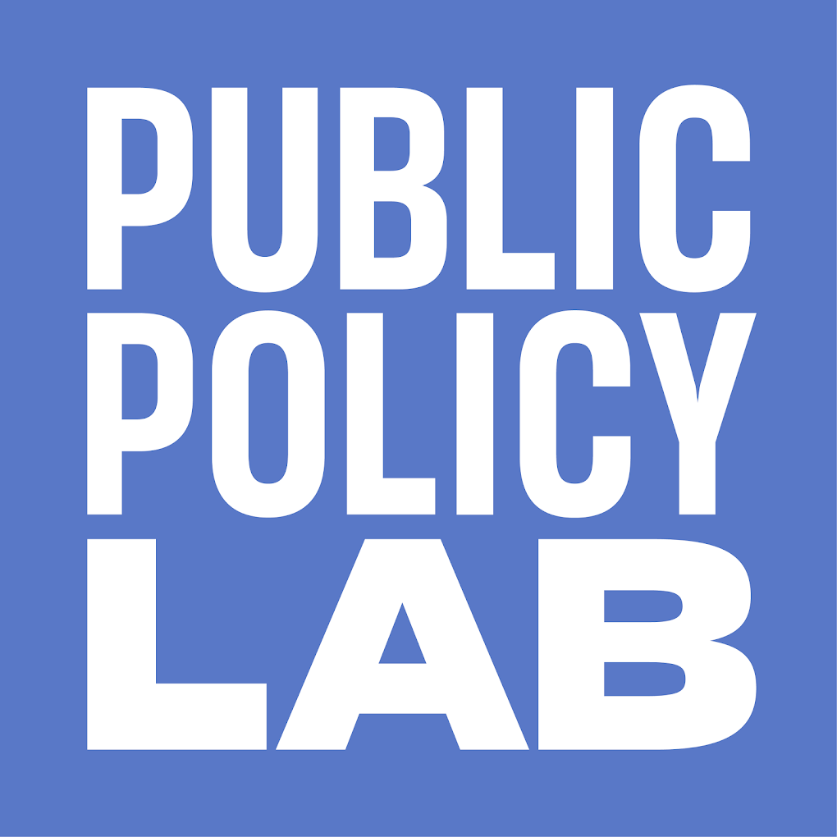
I ❤️ ICU
Please join me ☺

Slide 33
Appendix
Some useful places to look for interesting, evidence-based scholarship:

Slide 34
What are the flagship journals in Public Policy?
Journal Name | Publisher / Affiliation | Focus / Description
Policy Studies Journal (PSJ) | Wiley / Policy Studies Organization | Leading journal focusing on policy theory, process, and empirical studies across policy areas.
Journal of Public Policy (JPP) | Cambridge University Press | Covers policy theory, design, implementation, and evaluation globally.
Review of Policy Research (RPR) | Wiley / Policy Studies Organization | Focuses on the intersection of science, technology, and public policy.
Journal of Policy Analysis and Management (JPAM) | Wiley / Association for Public Policy Analysis & Management (APPAM) | Highly respected; bridges academic research and policy practice.
Governance | Wiley / IPSA Research Committee on the Structure and Organization of Government | Covers comparative public policy, institutions, and governance.
Policy & Politics | Bristol University Press | Interdisciplinary journal emphasizing theory and practice in policy research.
Public Administration Review (PAR) | Wiley / American Society for Public Administration | Includes public policy and public administration research; practitioner-oriented.
Public Policy and Administration | SAGE | Focuses on public policy, management, and administrative reforms.
Evidence & Policy | Policy Press | Emphasizes evidence-informed policy-making and knowledge use in government.
Policy Sciences | Springer | Theoretical and normative approaches to policy research; influenced by the policy sciences tradition (e.g., Lasswell).

Slide 35
What are the flagship journals in Political Science?
Journal Name | Publisher / Affiliation | Notes
American Political Science Review (APSR) | Cambridge University Press / American Political Science Association (APSA) | The top generalist journal in the field; publishes leading research across all subfields.
American Journal of Political Science (AJPS) | Wiley / Midwest Political Science Association (MPSA) | Prestigious and highly cited; known for strong empirical and quantitative work.
Journal of Politics (JOP) | University of Chicago Press / Southern Political Science Association | Another top-tier general journal, publishes both theoretical and empirical work.
British Journal of Political Science (BJPolS) | Cambridge University Press | Highly respected internationally; publishes broad and interdisciplinary research.
Annual Review of Political Science | Annual Reviews | Invited review articles summarizing the state of the field; influential for setting research agendas.
World Politics | Cambridge University Press / Princeton University | Focus on comparative politics and international relations; rigorous and highly regarded.

Slide 36
Flagship University Press (and a few of the others) Publishers (Political Science and Public Policy)
Press Name | Strengths / Notes
Cambridge University Press | One of the top political science publishers globally; strong across all subfields including theory, IR, comparative, and public policy.
Oxford University Press (OUP) | Publishes foundational and cutting-edge works across the full spectrum of political science and policy studies.
Princeton University Press | High-profile books in political theory, IR, and political economy; strong reputation for scholarly and accessible books.
Harvard University Press | Known for influential books in political philosophy, democratic theory, and public policy; often bridges academic and general audiences.
University of Chicago Press | Prominent in political theory, American politics, and political development; publishes both empirical and conceptual works.
MIT Press | Especially strong in public policy, especially in technology, science policy, and environmental governance.
Brookings Institution Press | Focused specifically on public policy and governance, often written by scholars and practitioners for both academic and policy audiences.
Georgetown University Press | Specializes in public policy, international affairs, and ethics in public service.
Cornell University Press | Strong in comparative politics, public administration, and political development.
Yale University Press | Known for works in political theory, political history, and some key public intellectual contributions.
University of California Press | Interdisciplinary and progressive scholarship; strong in environmental policy, political sociology, and public affairs.
Routledge (Taylor & Francis) | A major commercial publisher with a large volume of public policy and political science books, including textbooks, handbooks, and research monographs.
Palgrave Macmillan | Publishes globally focused works in public policy and governance; also strong in international relations and comparative politics.
University of Michigan Press | Known for policy-focused books, especially in economics, governance, and regulation. Frequently used by practitioners and academics alike.

Slide 37
What`s a potential bias of those publications?
Oh snap, they are all western based!
Oh double snap—so am I!
All scholarship and scholars will have bias, understand the direction(s) of that bias, and work around it!
We need more science-based scholarship
Ganbare!

